Slide 1
Kitchen Wrath
Kinnear Wong, Rui Quan, Muhammad Salihin, Valentina Lee

Slide 2
What is it?
2D side Scrolling Platformer
Infinite Runner
Two-Button Press Game
Designed for Android (possibly iOS)
Target Audience: Children to Adults

Slide 3
Developers Tools
Unity 3D
Photoshop
Possible Extra Unity Plugins e.g. NGUI/Daikon Forge

Slide 4
Player Goals
Survive & Complete as many recipes as possible before time runs out
Stay on top of platforms
High Score

Slide 5
Story

Slide 6
Gameplay
Session estimated 30 Seconds to 1 minute 30 Seconds
Game ends if player falls through the gaps in-between platforms or when time limit expires
Left Button: Jump
Right Button: Slash

Slide 7
Player Motivation
Content filled sarcastic humor
Funny & Chaotic
Designed for Casual & Hardcore Gamers alike

Slide 8
Unique Features
Collect three items to match up and create a recipe
Recipe Discovery
Completing recipes give different types of positive attributes to the player
Random Generated Content

Slide 9
Modes
Normal Mode – Timer Based
Endless Mode – Run till the player dies

Slide 10
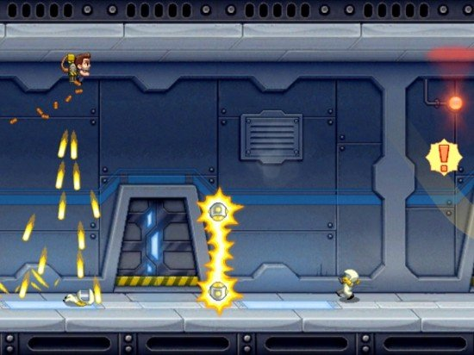
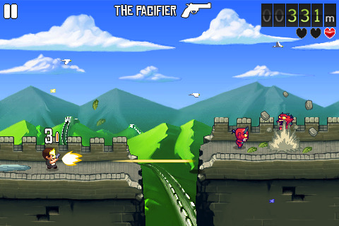
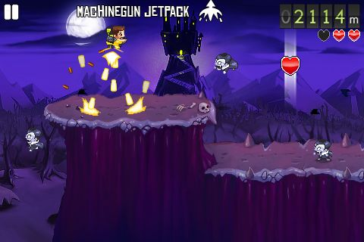
Art Style
Pixel Art
Cartoony

Slide 11
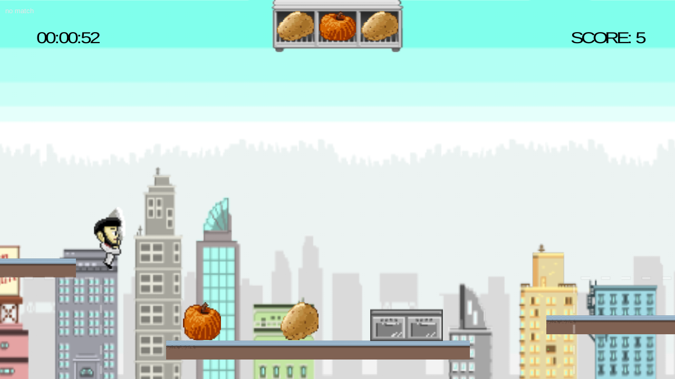
Prototype

Slide 12
Why This Idea?
Why A Chef? Because statistics show that a large number of games on the Play Store are Monsters, Ninjas especially Zombies. A chef will catch a potential player’s attention for download (Google for evidence)

Slide 13
Shop
Cosmetics
(More combo stoves? 3 to 5? Or?)

Slide 14
Planned Social Media Features
Share & Compare High scores on Facebook

Slide 15
Possible Risks
Insufficient Time due to a large scope
Might take a lot of time to implement very polished gameplay

Slide 16
Basic Schedule
1-2 : All Core Gameplay Features Implemented
4-5 : Shop, High scores, Facebook Integration, Interstitials
6-8 : Deep Polishing

Slide 17
Things Yet To Be Included
Sarcastic humorous gameplay
Proper Level/Platform Generation
Full-Range of Recipes
Polished UI
Any User Feedback e.g. Visual Effects, Camera Shake

Slide 18
Questions?

